Slide 1
Building Type Considerations
REVIT University
ORB UNIVERSITY – May 8th, 2024 PRESENTED BY Tim Rice
Notes:
We are doing a brief overview of the process we have been working on for the past 6 months. We have purged, revised, adjusted and renewed a lot of our standards, templates and processes to be able to meet the coming work with better efficiency and better results

Slide 2
3 MAIN TYPES:
GARDEN STYLE – Multiple Building Spread Across Site
WRAP (or Texas Wrap) – Residential Units Around Parking Garage
PODIUM – Single Building with all Services Contained Within
Notes:
Our template files have been revised. We now have 3 different templates that we will be using. 2023 template to be used for all types of projects: garden, wrap, single buildings, and as a documentation file. The unit files are now pre-loaded in here. The survey file where the ALTA and civil information lives The Unit interior template only to be used when a new unit is created.

Slide 3
GENERAL CODE CONSIDERATIONS FOR ALL TYPES:
BUILDING CONSTRUCTION TYPE
TYPES DEFINED IN IBC SECTION 602
ALLOWABLE BUILDING HEIGHT
TABLE 504.3 HEIGHT IN FEET ABOVE GRADE PLANE
ALLOWABLE NUMBER OF STORIES
TABLE 504.4 NUMBER OF STORIES ABOVE GRADE PLANE
ALLOWABLE AREAS
TABLE 506.2 ALLOWABLE AREA IN SQUARE FEET
COMBINED, HELPS DETERMINE WHICH BUILDING TYPE WILL WORK BEST FOR PROJECT
SPRINKLERS COUNT!
Notes:
Definition of Grade Plane and exceptions to height also defined
Stories more specific to different occupancies than height is
Allowable Areas can be affected by multi-use occupancies
A “single building” can be split into several “buildings” using the right kind of partition
A podium building uses a Horizontal Separation to gain additional height/ number of stories and area
Stairs and shafts become rated and protected once over 3 stories
Fire Riser Standpipes in stairs

Slide 4
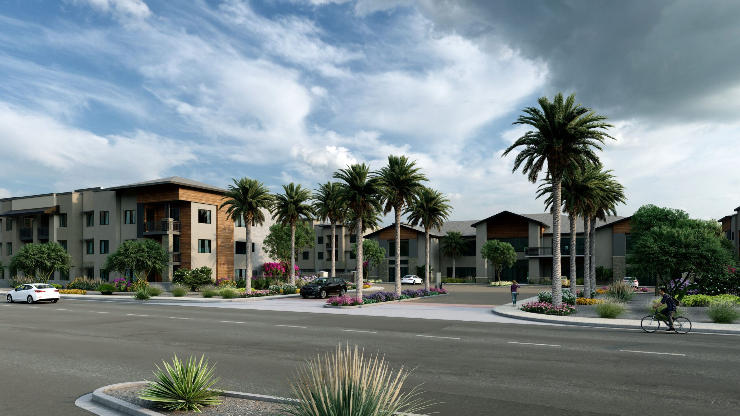
1. GARDEN STYLE
Notes:
Our template files have been revised. We now have 3 different templates that we will be using. 2023 template to be used for all types of projects: garden, wrap, single buildings, and as a documentation file. The unit files are now pre-loaded in here. The survey file where the ALTA and civil information lives The Unit interior template only to be used when a new unit is created.

Slide 5
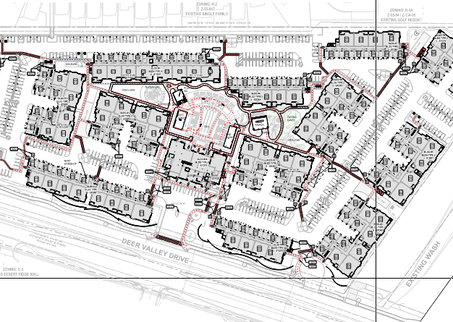
1. GARDEN STYLE : Accessible Paths of Travel
All of a development’s amenities must have a clear, defined and accessible Path of Travel to them, from each building, including:
Parking Stalls
Trash Receptacles
Mail Kiosks
Clubhouse
Outdoor Amenities
Loading Zones
Notes:
Being several buildings over a large site means having to provide an Accessible Path of Travel to reach all of them.
IBC 2018 Chapter 11 – Accessibility : Defers to ICC A117.1 to establish the technical provisions of how Accessibility criteria are address by IBC.

Slide 6
1. GARDEN STYLE : Accessible Path of Travel
IBC Section 11 provides scope of what needs to be connected and how, to qualify as an Accessible Path
Section 1104.1 Site Arrival Points states:
At least one accessible route within the site shall be provided from public transportation stops, accessible parking, accessible passenger loading zones, and public streets or sidewalks to the accessible building entrance served.
Notes:
Can’t forget that the development itself needs to be connected to the outside public paths.

Slide 7
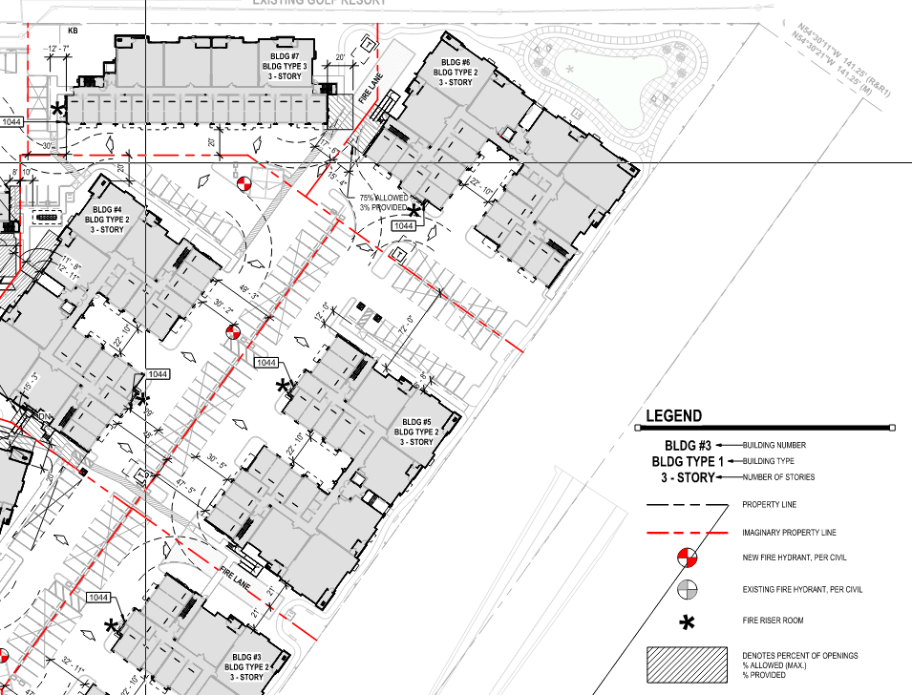
1. GARDEN STYLE : Building Separation Distance
Individual buildings have Imaginary Property Lines surrounding them
Table 602 determines what rating exterior walls need to meet based on distance between buildings and Type of Construction. This is above and beyond what's required Table 601.
Over 30’ can be unrated
Distance from Imaginary Property Lines also carries allowances for Permitted Openings
Notes:
Table 601 requires certain ratings for particular building elements, by construction type

Slide 8
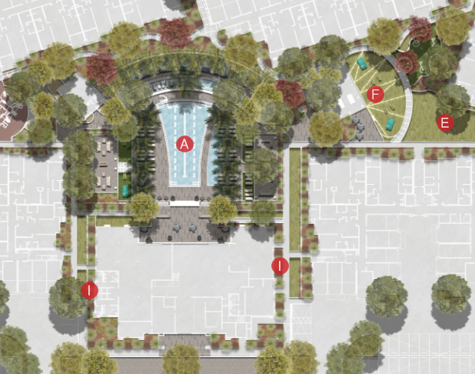
1. GARDEN STYLE : Local Zoning Codes
Items like:
Unit Density Per Acre allowed
Building Setback Lines
Open Space Required
Parking Lot Layout Requirements
Landscaping
City Zoning and Building Codes are required to be followed by all project types but can get more difficult with larger sites.

Slide 9
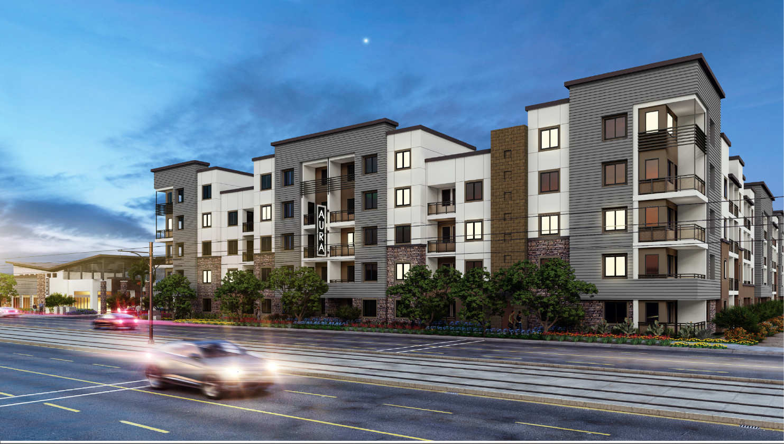
2. WRAP STYLE
Notes:
Texas Doughnut

Slide 10
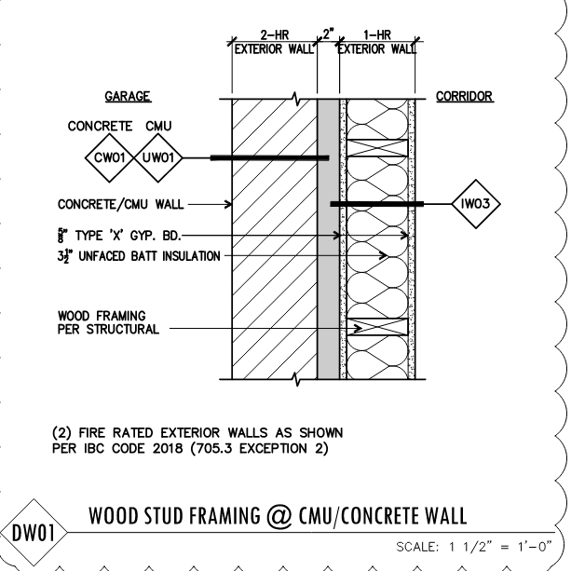
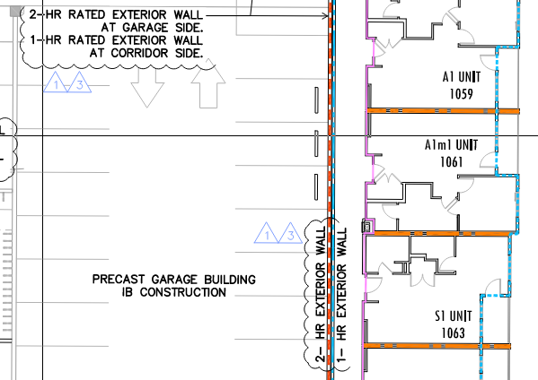
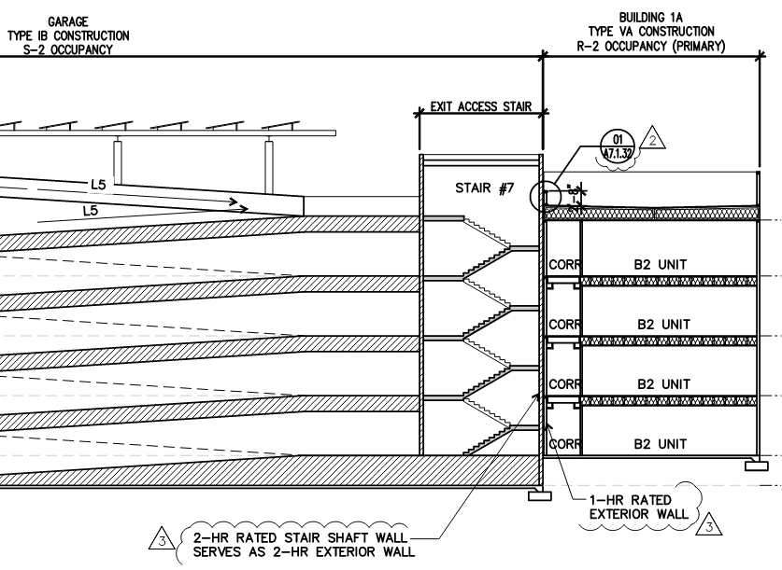
2. WRAP STYLE: OCC/CONST SEPARATION
IBC Table 508.4 lists separation required in hours between different Occupancies.
Notes:
Parking Garages are Type I Construction, usually wrapped with Type V
Parking Garages are Occupancy Type S-2, usually wrapped with Type R-2
Important to consider where parapets between vary
Life Safety Coversheet!!!!!!!!

Slide 11
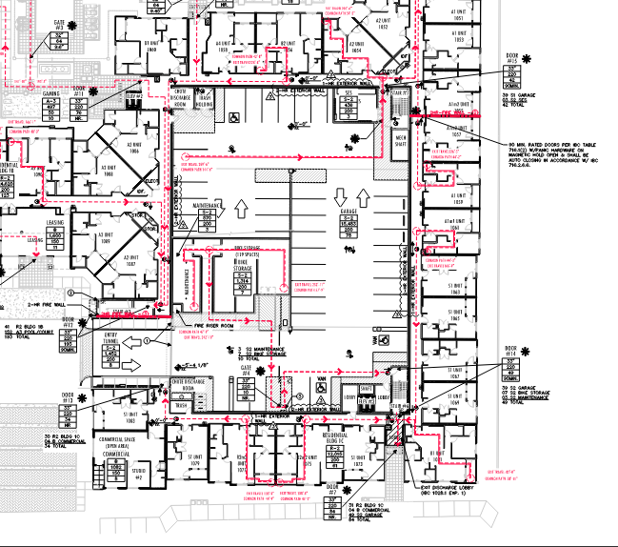
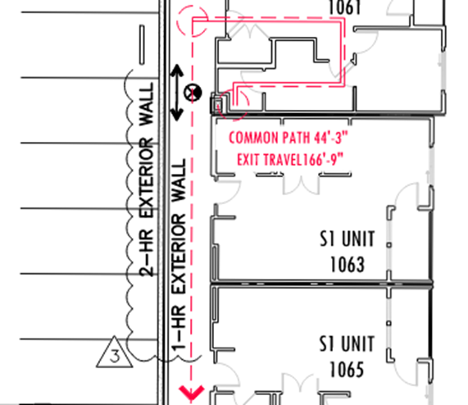
2. WRAP STYLE – PATH OF TRAVEL DISTANCE
IBC TABLE 1017.2 EXIT ACCESS TRAVEL DISTANCE
Most commonly used is 250’ for R occupancies with sprinkler system, but far from only.
Notes:
Distance needs to be taken all the way to the exterior
Horizontal Exit Paths from stairs in garages

Slide 12
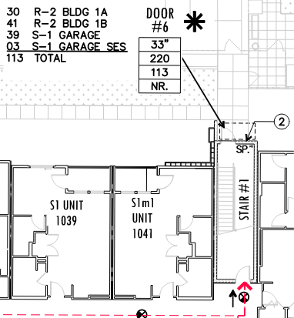
2. WRAP STYLE – MEANS OF EGRESS WIDTH
IBC TABLE SECTION 1005
Includes all “components” of an Egress Path
Based on Occupancy Load
Notes:
Distance needs to be taken all the way to the exterior
Horizontal Exit Paths from stairs in garages

Slide 13
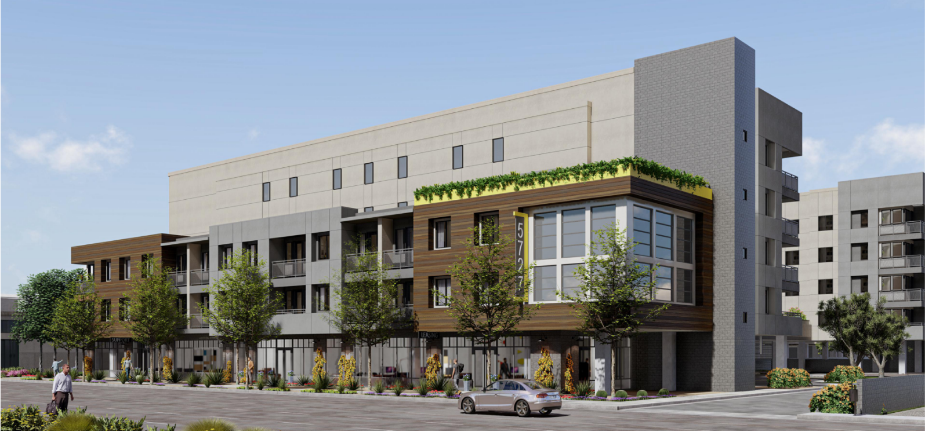
3. PODIUM

Slide 14
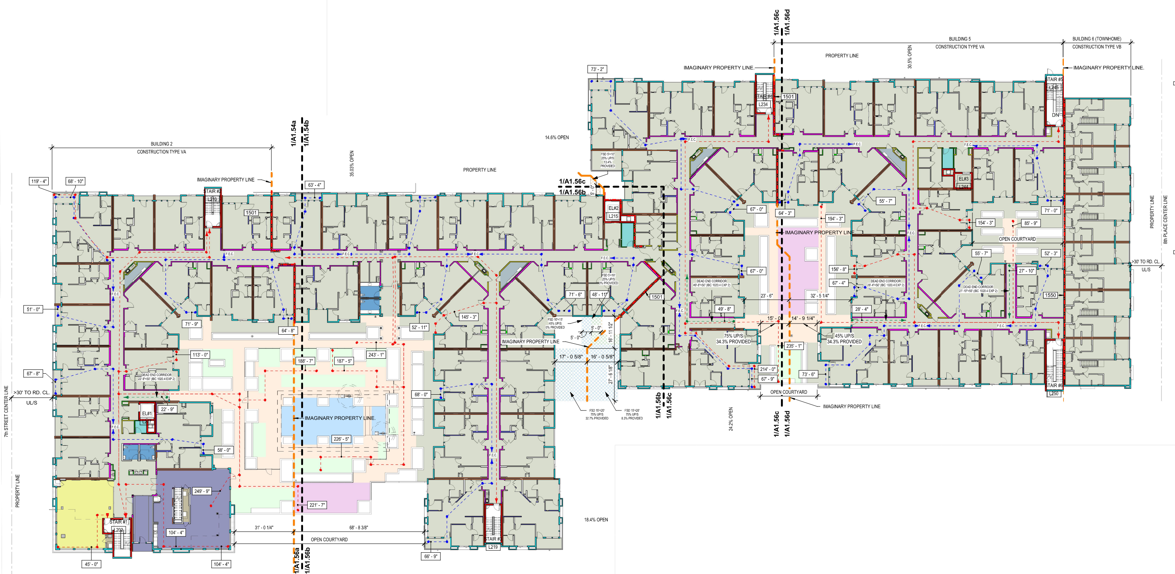
3. PODIUM
Shares Most of the Same Considerations as other types
Notes:
A 5-over-1 or 5-over-2 up to 5 floors over 1 or 2 floors
Or Type V construction over Type I construction
Started in Los Angeles in 1996 by Tim Smith on a 100- unit affordable housing project

Slide 15
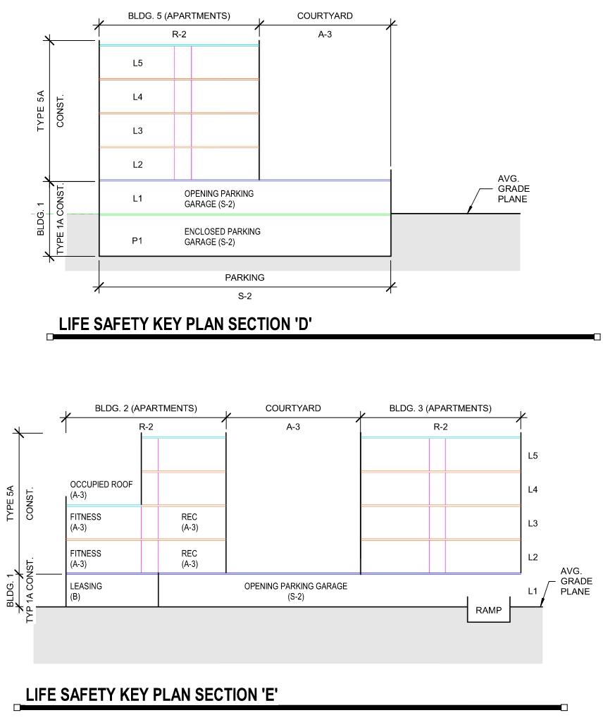
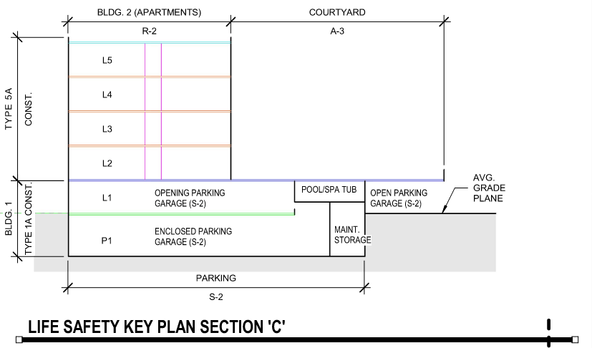
3. PODIUM – HORIZONTAL SEPARATION
Podiums provide “building” split between floors, rather than running within them.

Slide 16
3. PODIUM – WHY?
REMEMBER THESE?
ALLOWABLE BUILDING HEIGHT
TABLE 504.3 HEIGHT IN FEET ABOVE GRADE PLANE
ALLOWABLE NUMBER OF STORIES
TABLE 504.4 NUMBER OF STORIES ABOVE GRADE PLANE
ALLOWABLE AREAS
TABLE 506.2 ALLOWABLE AREA IN SQUARE FEET
The addition of a podium increases Allowable Height and Number of Stories.
Construction Type I has higher Allowable Area because of non-combustible (limited-combustible) construction.

Slide 17
WRAP UP:
LIFE SAFETY is the distinguishing factor
No matter the type, all buildings follow the same codes
“Separation” happens in a lot of places for a lot of reasons
We have years of experience doing all, which means resources are at our disposal
Notes:
All the information you need to create the construction documents is already here except for detail sheets. Detail sheets will be downloaded from HIVE when the PM has reviewed the project and has chosen which details belong to your specific project. When starting a project, contact your BIM manager, either myself or Miguel (who will now start to train as a BIM manager)

